Slide 1
U.NIKESHKUMAR
Final Project
3/21/2024 Annual Review

Slide 2
PROJECT TITLE
Black and white image colorization with opencv and deep learning
3/21/2024 Annual Review

Slide 3


AGENDA
Embarking on black and white image colorization involves understanding image fundamentals and deep learning principles. With OpenCV as the backbone, data collection, model building, and training ensue. Evaluation metrics guide refinement, leading to seamless integration with OpenCV for practical use. Rigorous testing and documentation ensure reliability and pave the path for future enhancements.
3/21/2024 Annual Review

Slide 4

PROBLEM STATEMENT
Colorization of black and white images using OpenCV and deep learning presents a challenge in bridging historical imagery with modern visual expectations. Leveraging deep learning architectures, this project aims to develop a system that accurately infuses grayscale images with color, employing robust methodologies within the OpenCV framework.
3/21/2024 Annual Review

Slide 5

PROJECT OVERVIEW
This project aims to transform black and white images into colorized versions using OpenCV and deep learning techniques. Through the integration of OpenCV for image processing and deep learning frameworks like TensorFlow or PyTorch, grayscale images are analyzed, and color information is inferred and applied. The process involves data preprocessing, model building, and training, culminating in a seamless integration with OpenCV for practical use. Evaluation metrics validate the effectiveness of the colorization process, ensuring accuracy and quality.
3/21/2024 Annual Review

Slide 6

WHO ARE THE END USERS?
The end users of black and white image colorization with OpenCV and deep learning span various domains. Historians and archivists utilize it to revitalize historical photos, while artists employ it for creative expression. Additionally, photographers and graphic designers leverage it for restoration and enhancement projects. Moreover, individuals with personal photo collections seek to breathe new life into cherished memories
3/21/2024 Annual Review

Slide 7

YOUR SOLUTION AND ITS VALUE PROPOSITION
Our solution merges OpenCV's robust image processing capabilities with the power of deep learning, enabling accurate and efficient colorization of black and white images. By seamlessly integrating these technologies, we deliver a versatile tool that breathes life into monochrome visuals, offering creative freedom and enhancing the aesthetic appeal of images across various applications.
3/21/2024 Annual Review

Slide 8

THE WOW IN YOUR SOLUTION
The wow factor in our solution for black and white image colorization lies in the seamless fusion of OpenCV's robust capabilities with the power of deep learning. Through meticulous model building, training, and integration, we transform grayscale images into vibrant masterpieces. Rigorous testing ensures reliability, while comprehensive documentation sets the stage for further innovation and enhancement.
3/21/2024 Annual Review
8

Slide 9
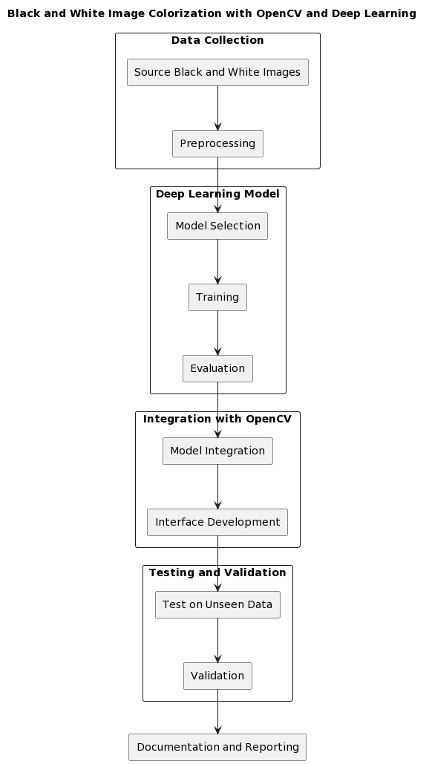
MODELLING
3/21/2024 Annual Review
9

Slide 10
RESULTS
The integration of OpenCV and deep learning for black and white image colorization yields remarkable results. By leveraging the power of deep neural networks, grayscale images are transformed into vibrant, lifelike representations. OpenCV provides robust tools for image manipulation and processing, enhancing the accuracy and efficiency of the colorization process. Through meticulous model training and optimization, coupled with comprehensive testing and validation, this approach produces compelling results that bridge the gap between traditional photography and modern AI-driven techniques.
Demo Link
3/21/2024 Annual Review
10

